Slide 1

The Robot Bartender
By Kavir, Reyansh and Promit
Notes:
ALL

Slide 2
Our Story
Original ideas included a boat that floats on water and collects trash, prosthetic limbs, and a robot waiter.
We settled on robot waiter which proved to be too complicated.
Turned into food industry, which resulted in our the MixMaster 3000
Notes:
Reyansh slide

Slide 3
We wanted to provide people with tasty and refreshing drinks.
So, please welcome…
Notes:
Kavir’s Slide

Slide 4
The MixMaster3000
Notes:
Kavir’s slide

Slide 5

Commercial perspective
Very profitable
Attractive to customers
Large market
Notes:
Reyansh’s slide
The base idea of this project is quite interesting to many people, and if our design was refined and people made it look better, could be large in the marketplace for restaurants, hotels, bars, etc. This is because our project could be refined, made look excellent and increased number of drinks for under 50 thousand rupees, while a real bartender costs 2 lakhs per year to hire. This is a excellent way for hotels, restaurants, and bars to impress customers with a show, as well as save hundreds of thousands of rupees in the process. This leads to making the MixMaster 3000 into a very brilliant product.

Slide 6
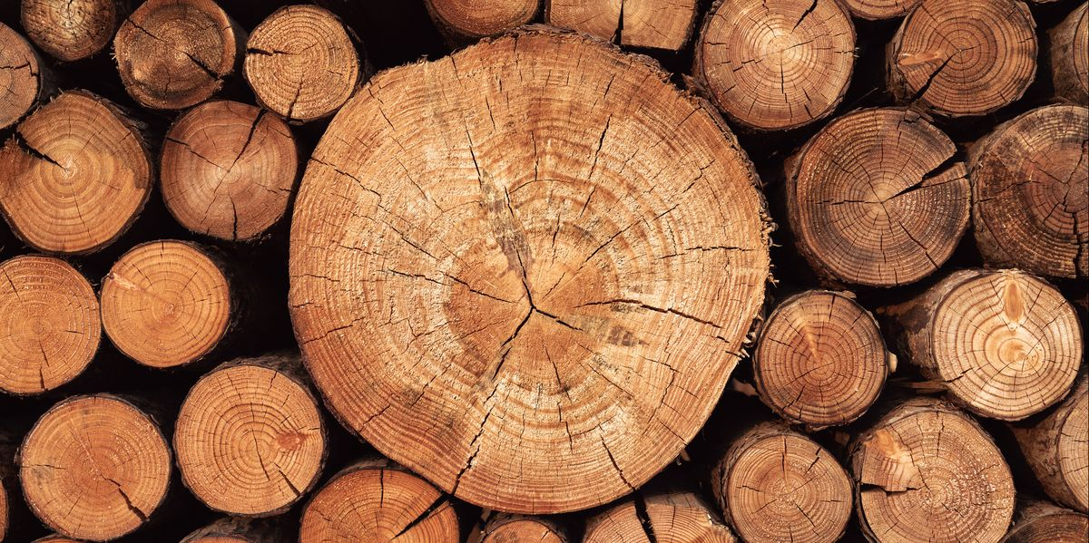
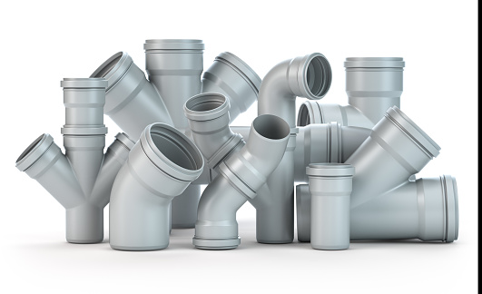

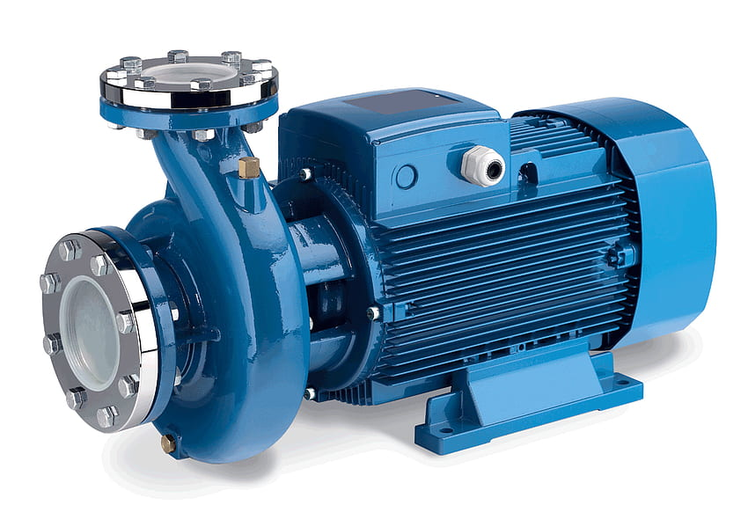
Materials
Frame:
Plywood
PVC Pipes
Wood Glue
Cardboard
Foamboard
Electronics:
Wires
DC pumps
Notes:
Promit’s slide

Slide 7
So, How does it work?
Notes:
Promit slide

Slide 8
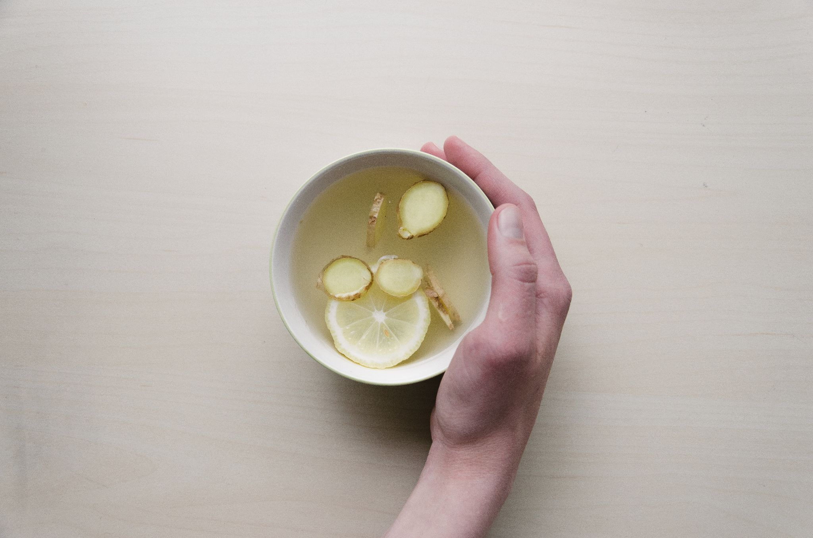
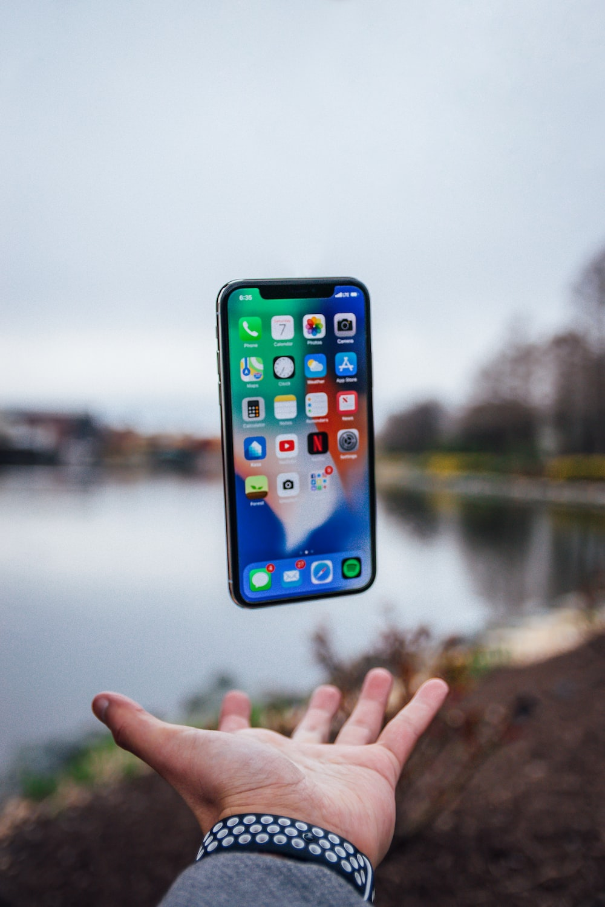
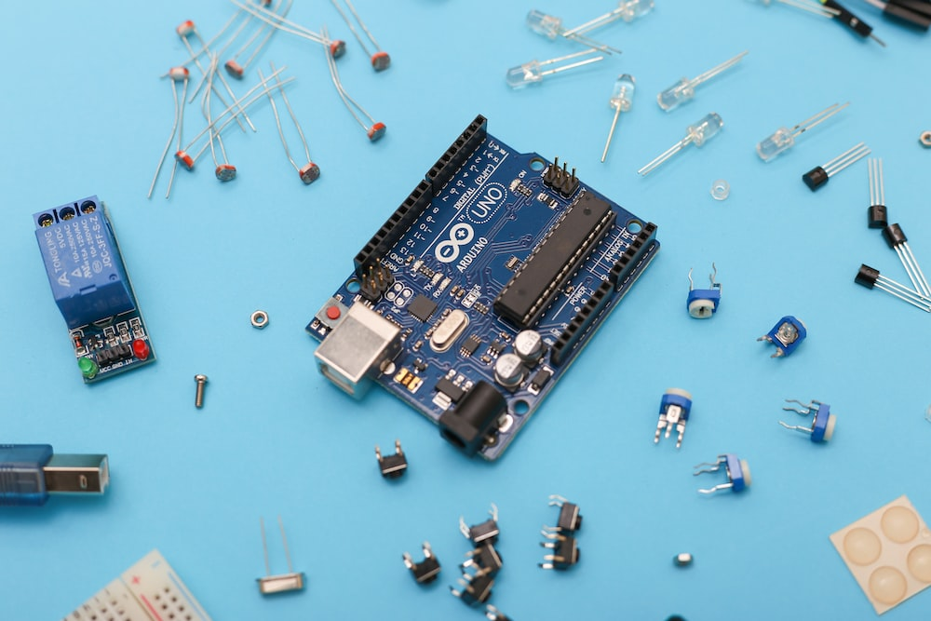
Procedure
Select the drink with the app, your choice will then be transmitted via bluetooth to the machine.
The machine will pump the required amount of liquid into the cup.
Your drink is ready!
Notes:
Promits slide

Slide 9

Some problems we faced.
Pumps came last minute
App was not good and had glitches
Many coding errors which took time to fix
Difficult to stick the wood pieces together. We didn't laser cut it so the pieces weren't perfect
Bought the wrong glue. Ended up using hot glue and fevicol
Notes:
Kavir slide

Slide 10
Now, a demonstration.
Notes:
ALL

Slide 11
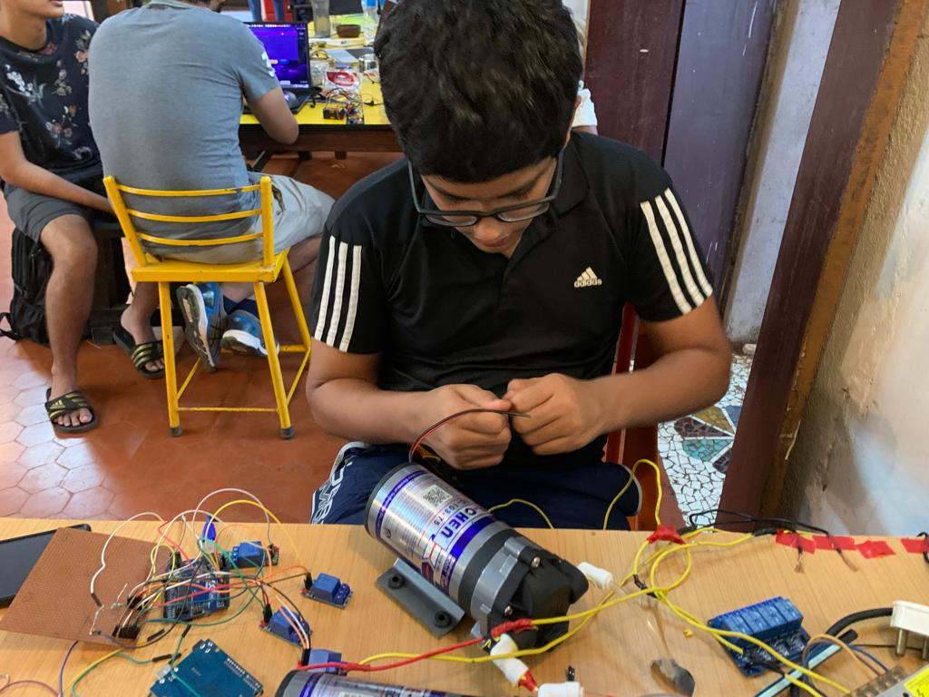
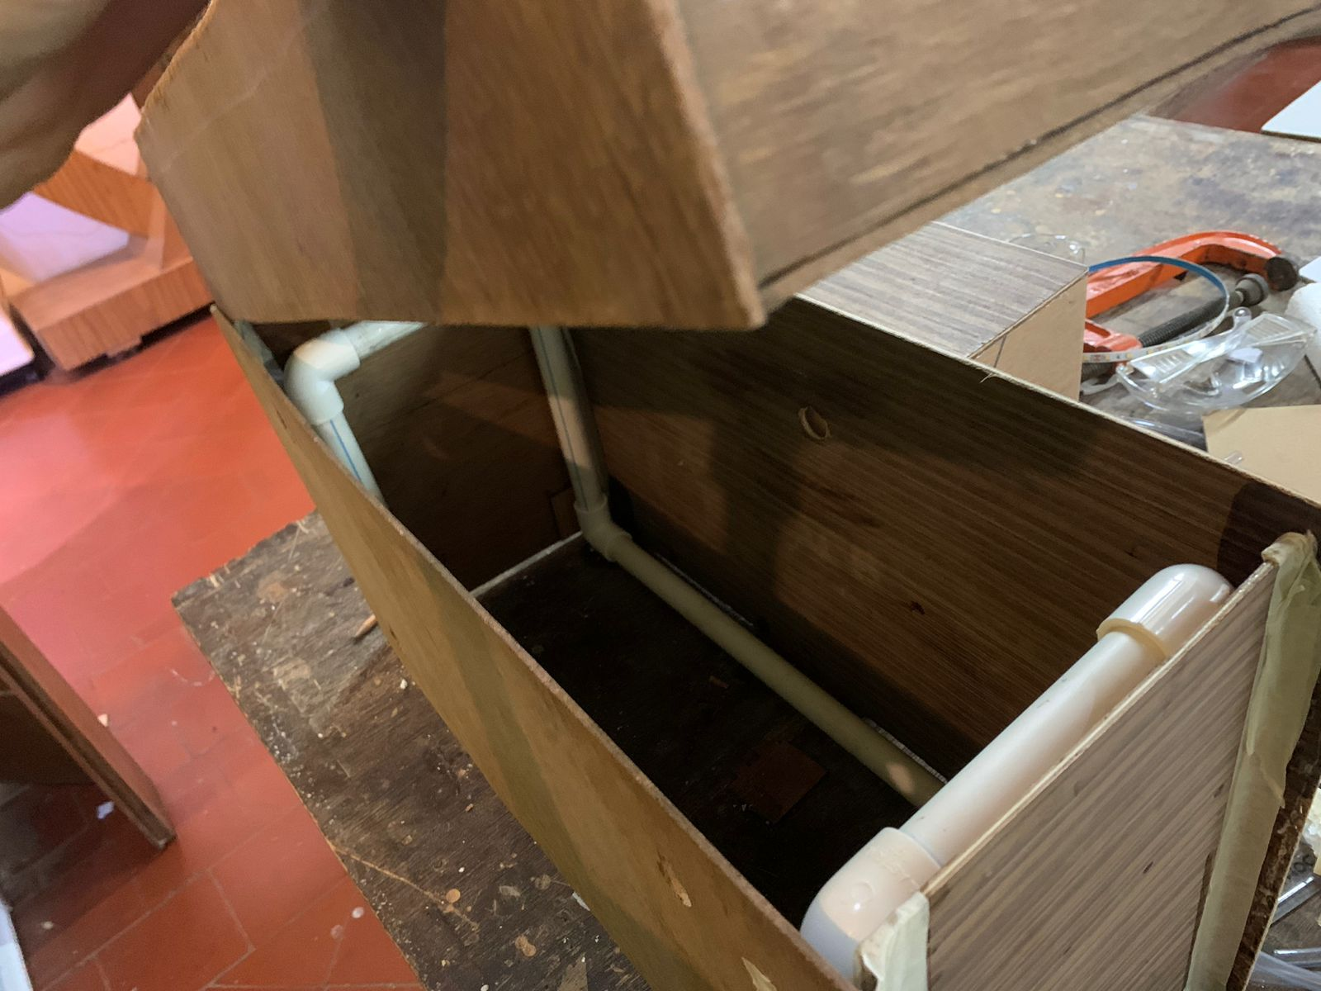
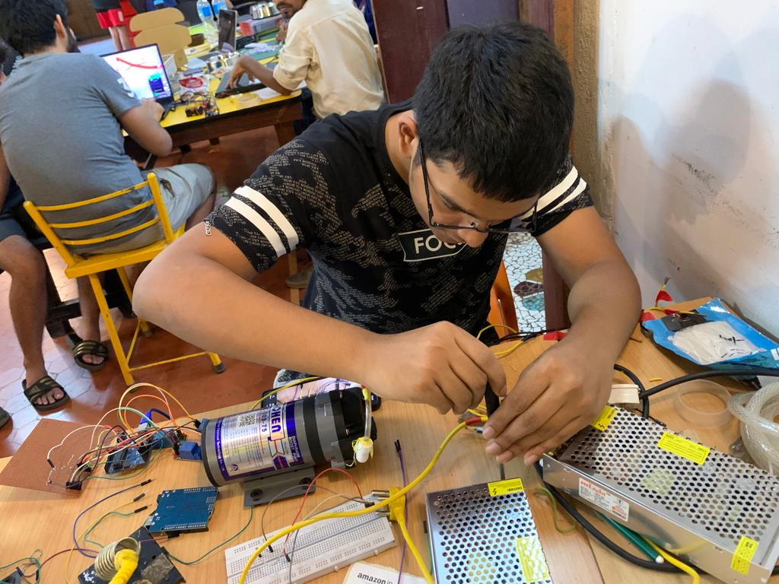
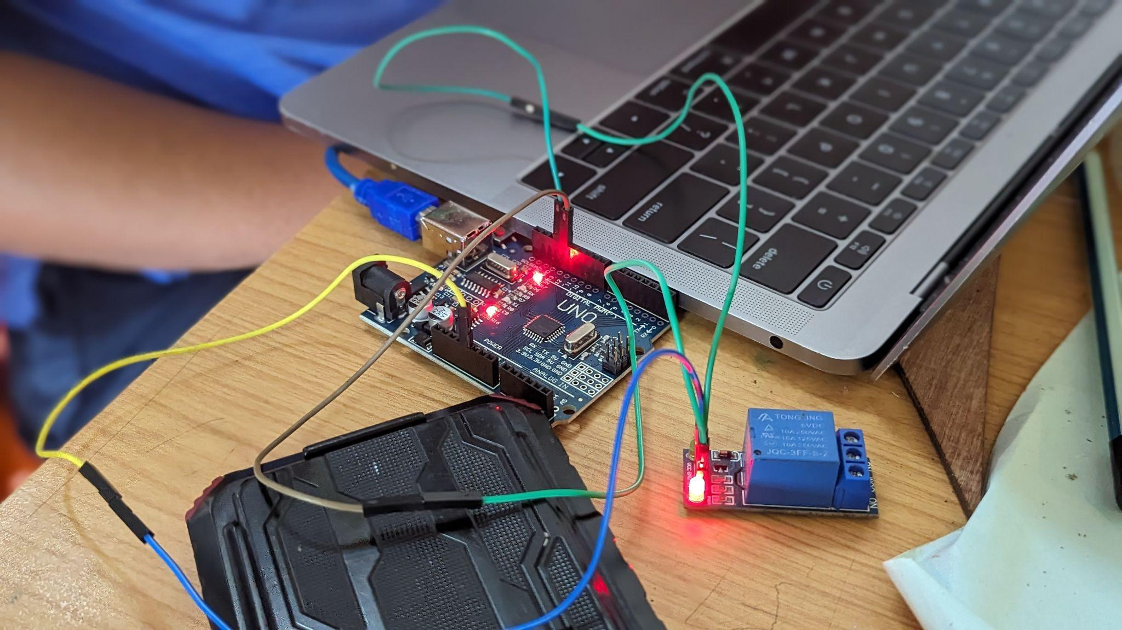
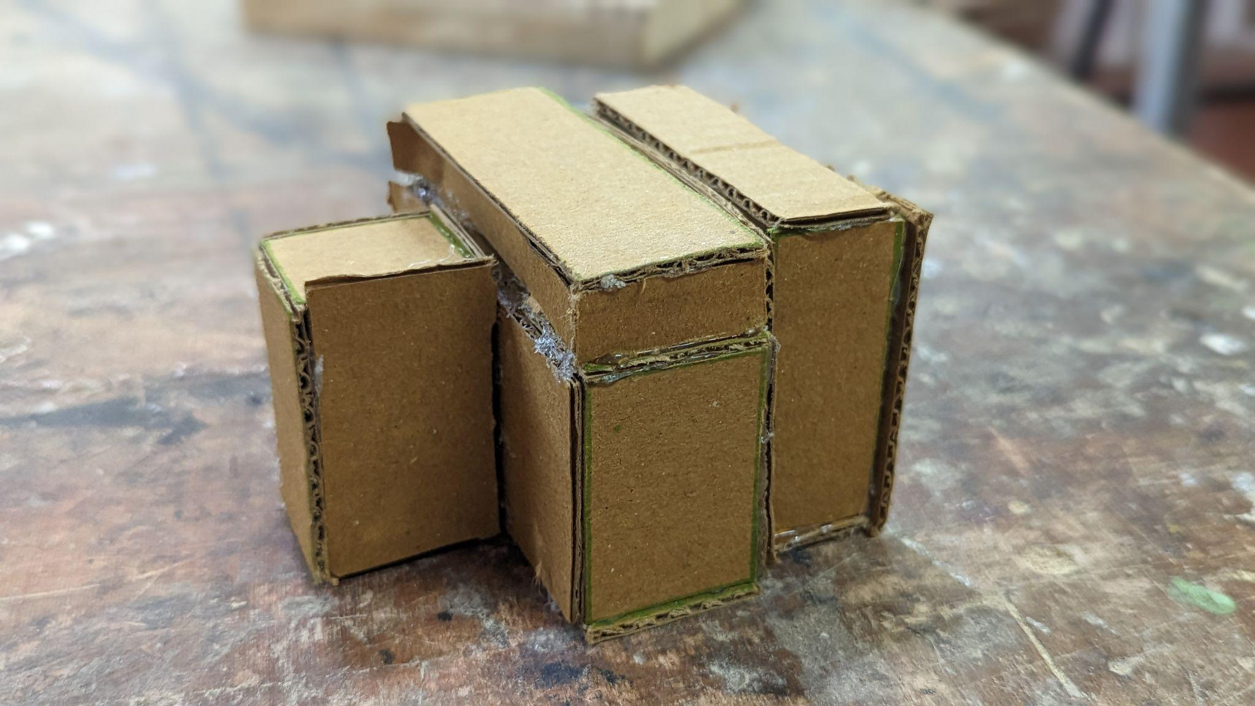
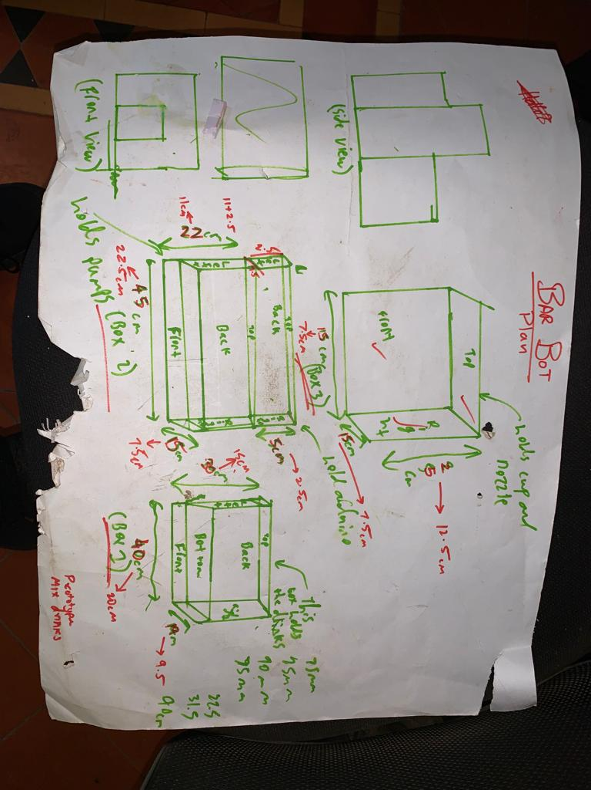
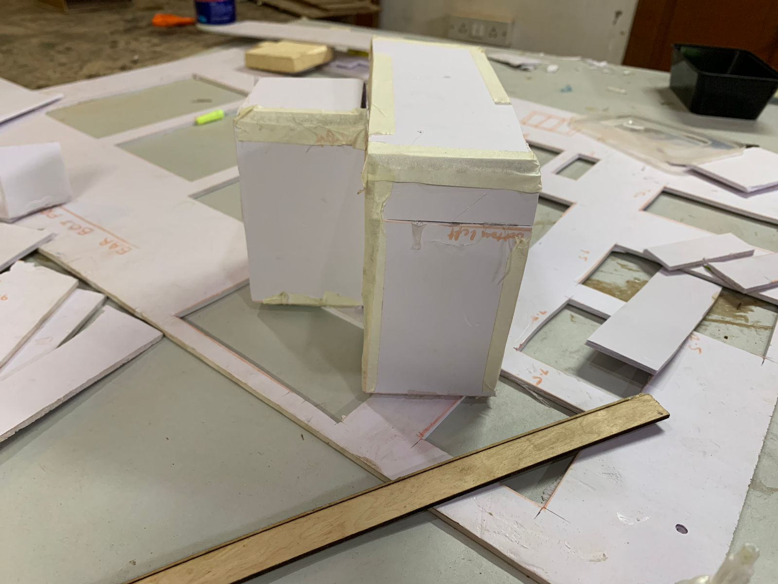
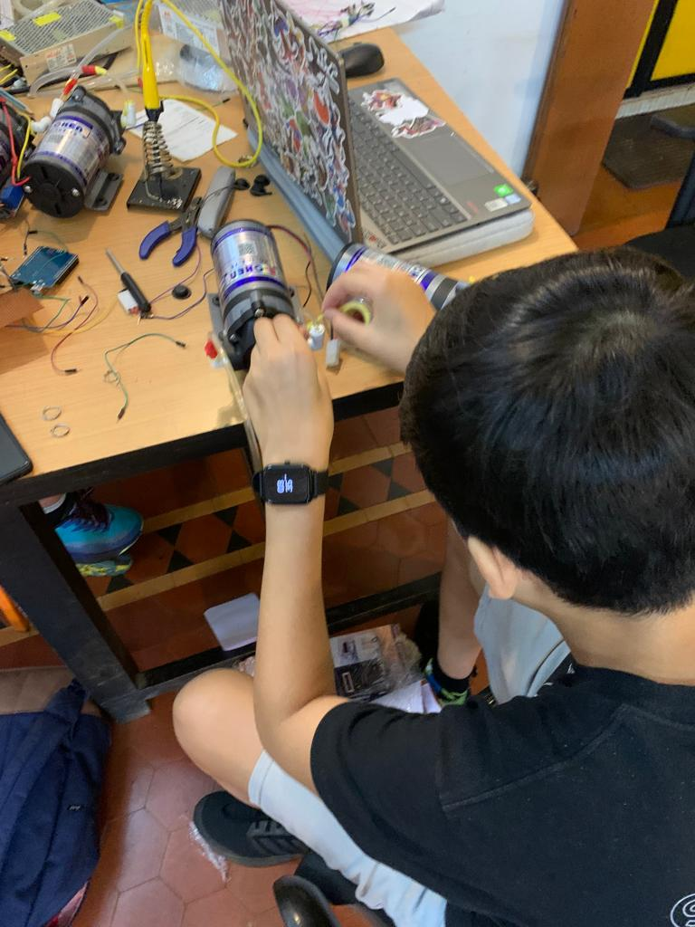
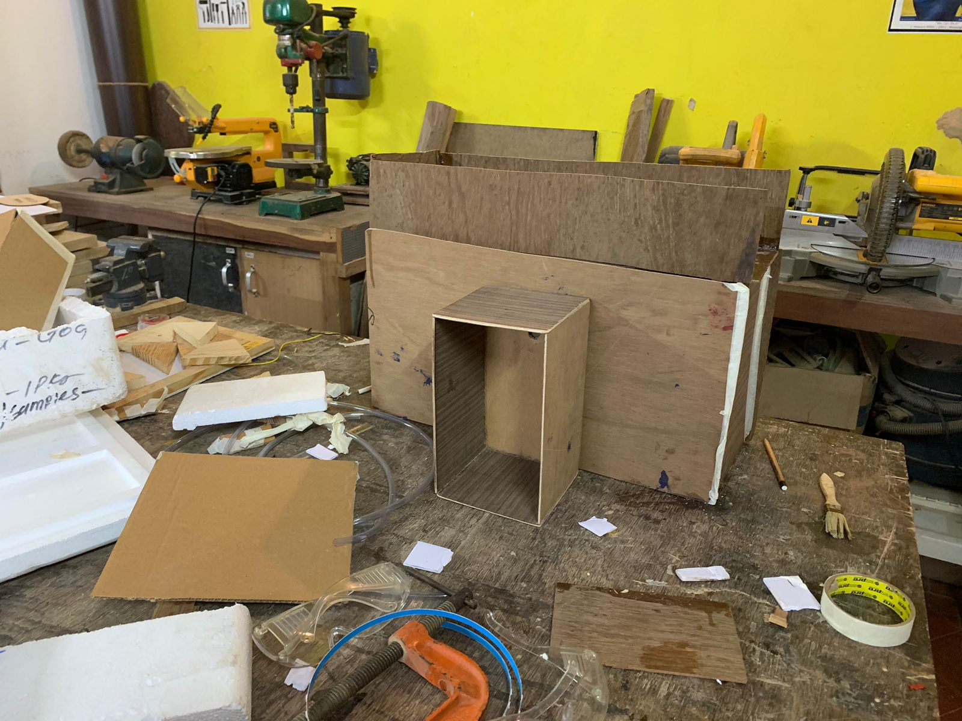
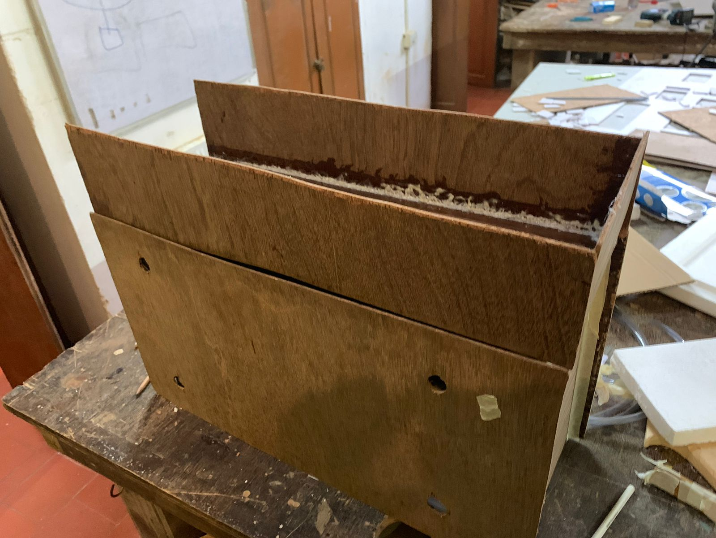
Some pictures from our time here!
Notes:
ALL

Slide 12

Thank You!
Notes:
ALL

